Slide 1

Adults at the
Center
May 12, 2016

Slide 2
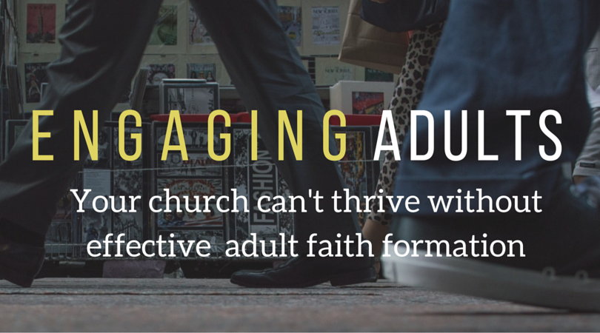
Notes:
10:45am
Does this resonate with you? It did for me.
It is something I have come to believe as a catechetical leader over time.
Today, I have a sense of urgency about it.
I hope you believe it too, to embrace it as a priority and to make a commitment to put adults in the center of faith formation

Slide 3

What parishes in the
Diocese of San Jose are already doing:
83% spiritual prayer groups and scripture study
69% one time speaker event
65% have adult faith formation teams
62% adult retreats
60% service programs
51% speaker series
34% grief ministry
30% family retreats
18% online faith formation to adults
11% faith formation for aging adults
Notes:
10:46 am
These statistics are taken from the 2015 diocesan catechetical report on adult faith formation.
Insights? Where are we currently putting our efforts?

Slide 4
Overview of our conversation
What do we mean by adult faith formation?
How do we nurture adults in Christ-centered spirituality?
Why accompaniment is essential to evangelization and adult faith formation?
What does fruitful adult faith formation look like?
How do we place this task at the center of our community?
Notes:
10: 47 am
This morning, through presentation and conversation we will reflect on the importance of putting adults at the center of faith formation.
In the afternoon, we will reflect on our response to this challenge using the working document, “Adults at the Center… a roadmap.”
Refer to slide:
Here is the overview of what we will be covering before lunch.
10:48 am Sharing in pairs ( 4 minutes)
How do you understand adult faith formation?
10:52am Large group sharing of words or phrases that describe adult faith formation

Slide 5
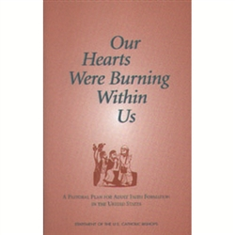
Our Hearts Were Burning Within Us
USCCB, 1999
In the document, the bishops emphasized the importance of Adult Faith Formation by saying
that it must be:
  At the heart of catechetical vision and practice (#6)
  The chief form of catechesis (#13)
  A priority (#13)
The Bishops had no intention of neglecting catechesis for children and youth, but they were serious about putting adult catechesis at the center of all catechesis – not as an after-thought -- and they have pledged their support for this.
Notes:
10:55am
In preparation for today’s gathering I invited you to review the Introduction and Chapters I and II of Our Hearts Were Burning Within Us.
This document gives us our marching orders.
Refer to slide.
Now, if you were to give one reason why adult faith formation should be a priority in your parish today, what would you say?
Think for a minute then turn to a partner and share it – 1 minute each
11:00 am Large group feedback – 3 min
If not mentioned in feedback, add:
Adults are responsible for being evangelizers to the next generation – responding to teachable moments in families, answering questions and objections with confidence and faith,
above all: being witnesses. You cannot witness to what you don’t have or what you don’t practice!
Disciples make disciples!
Lay ministers need formation in order to serve the Church as competent and credible representatives.

Slide 6
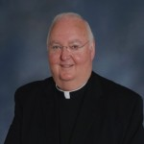
What the Bishops say . . .
“…adults ‘have the greatest responsibilities and the capacity to live the Christian message in its fully developed form.’
Their formation in faith is essential
for the Church to carry out its mandate
to proclaim the Good News
of Jesus to the world.”
Our Hearts Were Burning Within Us, #38
Notes:
11:03 am Refer to slide:
Now, let us listen to what Bishop McGrath has to say to us:
Share the videotape of Bishop McGrath’s comments and words of support.
11:07 What are you feeling after hearing our Bishop?

Slide 7
Our Hearts Were Burning Within Us
Goals of Adult Faith Formation
Invite and Enable Ongoing Conversion to Jesus in Holiness of Life.
Promote and Support active Membership in the Christian Community.
Call and Prepare Adults to Act as Disciples in Mission in the World.
Notes:
11:10am
Three goals of Adult Faith Formation in Our Hearts Were Burning Within Us
Invite and enable ongoing conversion to Jesus in Holiness of Life.
Promote and support active membership in the Christian Community
Call and prepare adults to act as Disciples in Mission in the World.
Where do you think most adult Catholics are, goal 1, 2 or 3?
Membership faith:
Most adults live in membership faith,
conformity with the group,
faith is dependent on the group,
the risks of membership faith are stagnation, complacency,
Discipleship faith:
It is often precipitated by crisis or struggle.
I am myself and I take responsibility for my beliefs.
Faith is independent, primacy of informed conscience

Slide 8
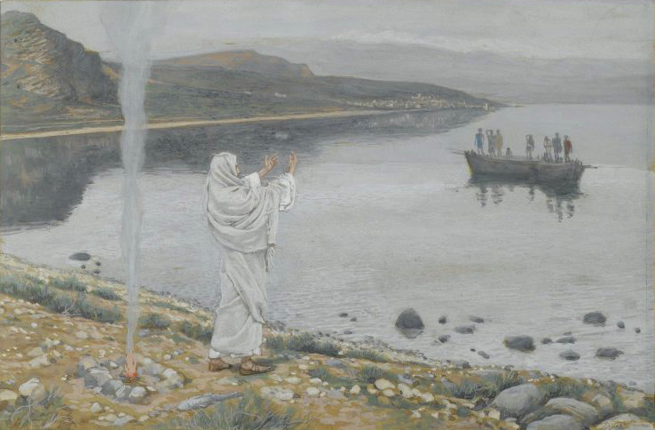
Why do formation?
To put people in relationship with God in Christ
To help people understand that relationship
To help people grow and deepen that relationship
Notes:
11:11 Refer to slide:
What word do you see in all three reasons to do formation?
Formation grows the relationship.
What does these three reasons tell you about formation?
(We need to be aware what level people are in to help them move to the next level.)

Slide 9
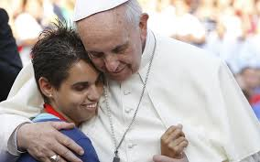
Encountering Christ
Notes:
11:12am
Pope Francis asks a great reflection question in The Joy of the Gospel to motivate us to put people in relationship with God in Christ.
“For if we have received the love which restores meaning to our lives, how can we fail to share that love with others? (8)”
Read this quote:
“I invite all Christians, everywhere, at this very moment, to a renewed personal encounter with Jesus Christ, or at least an openness to letting him encounter them.” Pope Francis, The Joy of the Gospel
Pope Francis is calling us to a different sense of catechesis, one that is based on experience and encounter.
Christian faith is relationship…. born of an encounter with God in Jesus Christ.
Jesus Christ is our source and inspiration of all our efforts at evangelization and catechesis
Jesus is the evangelizer! We are able to evangelize through our discipleship to Jesus.

Slide 10
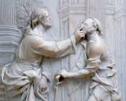

Encounter first
The first task of adult faith is conversion to Jesus Christ
“Follow me, and I will make you
fish for people.” (Mt 4:19)
“And who is he, sir? Tell me, so that I may believe in him.” (Jn: 9:36)
Notes:
11:14am The first task of adult faith is that: The person of Jesus becomes a reality in our lives, not a concept of faith, but a real person-in-relationship with us.
“The Christian faith is, above all, conversion to Jesus Christ. . . . Faith is a personal encounter with Jesus Christ, making of oneself a disciple of him. This demands a permanent commitment to think like him, judge like him, and to live as he lived.” GDC. #53
What does this quote from Co-Workers in the Vineyard of the Lord say to you about encountering Christ and our role in it?
“Spiritual formation cannot produce [this encounter], but spiritual formation can teach and help those who seek it, prepare them to receive it, and, when it is given, develop its fruits in their lives and ministry.” Co-Workers in the Vineyard of the Lord, p.38
How do we prepare people to receive this encounter?

Slide 11
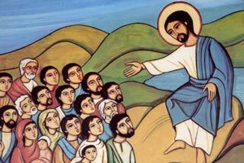
Joy of the Gospel
“On the lips of the catechist the first proclamation must ring out over and over:
“Jesus Christ loves you; he gave his life to save you; and now he is living at your side every day to enlighten, strengthen and free you.” Joy of the Gospel 164
Notes:
11:17 am
Pope Francis tells us that “this first proclamation is called “first” not because it exists at the beginning and can then be forgotten or replaced by other more important things. It is first in a qualitative sense because it is the principal proclamation, the one which we must hear again and again in different ways, the one which we must announce one way or another throughout the process of catechesis, at every level and moment. Joy of the Gospel (164)”
We need to share the Good News!

Slide 12
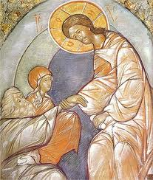
The Good News!
God is not an absent Father. (God is here, now.)
There’s nothing to be afraid of. (God saves us from darkness and fear.)
God brings justice and righteousness. (God is always just, fair, and righteous.)
Jesus is a big deal. (Jesus completely reveals God to us.)
We are a big deal too. (Disciples reveal Jesus to the world.)
It only gets better from here. (We’re on a path to perfect joy.) Nick Wagner, Catechetical Leader Jan. 2016
Notes:
11:18 am Joe Paprocki in Catechist Journal wrote recently:
“In adult faith formation, all too often, we set out to provide a comprehensive curriculum of the Catholic faith before we have helped folks recognize what exactly is the good news.”
We need to share the Good News in everyday language.
Refer to slide to see how Nick Wagner synthesized the essence of the Good News
in Catechetical Leader Magazine (NCCL) “Six Amazing Things Every RCIA Inquirer Has to Learn.” These are six amazing things every Catholic needs to know so they will be able to articulate what exactly is the Good News of Jesus
These core principles of the Good News is at the heart of everything we teach.
Leisa Anslinger says:
“We need to move from the head to the heart.
While teaching people about our faith is important, leading people to an encounter with Jesus and growing in relationship with him is crucial.
We have not been trained to do this. It is something we need to learn to do together. Without this, we will not be able to send people forth as missionary disciples.
CL magazine April 2016, Volume 27, Number 2, “Heart, Hands, and Head: Mentoring Adults in Faith”, by Leisa Anslinger

Slide 13

Some Signs of Conversion
A more comfortable sense of self
More flexibility with others
Growing sense of generosity
More patience with others
Stronger sense of hospitality towards others
A heart or the materially poor
Greater awareness of personal failures and sin
Growth in prayer, presence of God
Deep love for the Eucharist
Desire for more faith formation
Notes:
11:20am
There is a continuity between first proclamation and catechesis.
Catechesis must also be concerned with arousing initial faith and sustaining the gradual conversion to Jesus Christ.
Conversion is the change that comes in our lives through the power of the Holy Spirit.”
To make Jesus Christ the main dialogue partner of my life.
To live my life in ongoing exchange with Jesus
To allow Christ to touch me at the developmental points in my life
To allow Christ to lead me through death (letting go) and resurrection (unexpected gift)
Refer to slide. It is important to look for changes in the lives of people, to look for signs of conversion to discern if they are growing in faith.
Do Catholics think of themselves as converted to Jesus Christ?
Do we talk about signs of conversion with them? What would happen if we did?
Notice the last bullet. Conversion to Jesus instills a desire for more faith formation
Do you see the importance of focusing on preparing people to encounter Christ and experience conversion before doing catechesis on the teachings and traditions of the Church? Conversion motivates them to desire ongoing faith formation.

Slide 14

Accompaniment
Accompaniment is essential for evangelization.
Listening is essential for accompaniment.
To be effective ministers of adult
faith formation we will first,
like Jesus, join people in their
daily concerns and walk
side by side with them on
the pathway of life.
We will ask them questions
and listen attentively
as they speak of their
joys, hopes, griefs, and anxieties.” OHWB # 8
Notes:
11:23 am Refer to slide: How do we usually go about preparing adult formation programs. Frequently we start by talking, with our adult faith formation team or pastoral staff about what we think the adults need. Then we launch the program and wonder why a handful of the same people showed up. Because they came from our point of view. That is not the best place to start.
The bishops in OHWB invite us to a different strategy: “Start by listening to adults!” This wisdom is grounded in the trust that God is already working in their lives.
“Pope Francis’s groundbreaking new document “Amoris Laetitia” (“The Joy of Love”) asks the church to meet people where they are, to consider the complexities of people’s lives (304).
Accompaniment is essential for evangelization and formation.
How could we practice the art of accompaniment and mentoring adults?
The skill of listening is required. . Share story of Jennifer Donnelly grief ministry at St. Frances Cabrini
In the Wounded Healer, Henri Nouwen develops his approach to ministry with an analysis of sufferings -- a suffering world, a suffering generation, a suffering person, and a suffering minister. It is his contention that ministers are called to recognize the sufferings of their time in their own hearts and make that recognition the starting point of their service. For Nouwen, ministers must be willing to go beyond their professional role and leave themselves open as fellow human beings with the same wounds and suffering -- in the image of Christ. In other words, we heal from our own wounds
How comfortable are we ministering to those who are suffering?
# 1 factor responsible for success of adult faith formation efforts is “ Paying attention to what is on the hearts and minds of adults, what is going on in their lives, is crucial and cannot be overstated.
Our starting point of adult faith formation is the people. We need to put the needs of persons over content.
“Ministry among adults will succeed only if we start and stay with their lived experience of the spiritual journey and if we use strategies and techniques that help people identify, reflect upon, and share with trusted others their lives as disciples of Jesus.” Tom Zanzig
Program will not make disciples. Disciples make disciples.

Slide 15
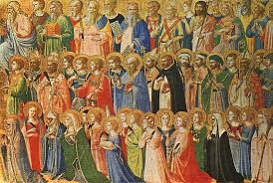
Adult Formation
Provide opportunities for:
Encounter
•To put people in relationship with God in Christ
Catechesis
•To help people understand that relationship
Deepening relationship
•To help people grow and deepen that relationship
Any one program will likely not facilitate all three opportunities!
Notes:
11:30 am
It is important that we provide adult faith formation opportunities for all three : encounter, catechesis and deepening relationship.
Do we determine where adults are before forming them? Do we open the doors wide for a variety of ways for people’s faith to grow?
What are ways we can mentor others in faith at these three stages?
1. Encounter: A faith mentor witnesses to the moments of encounter he or she has known, while encouraging the other to be attentive and open to such encounter. Encounter is one person at a time, it involves companionship, foot washing and mission, getting beyond comfort zones
2.Catechesis: We draw the person to Christ through active participation in the Mass, sacraments, prayer, learning and applying the faith in daily life. “We and Jesus” rather than “me and Jesus.”
3. Deepening relationship: We guide the person to generously give of self as Christ gives.

Slide 16

Effective
Adult Formation
Prayer
Retreats (both encounter and deepening experiences)
Spiritual direction
Small faith communities
A robust, integrated RCIA process
The homily
It may be best to do a few things well
rather than many things poorly.
Notes:
11:31am
If you are to choose some ways to form adults in faith here are the most effective ways.
These effective ways to form adults provide opportunities for encounter, catechesis and deepening the relationship.

Slide 17
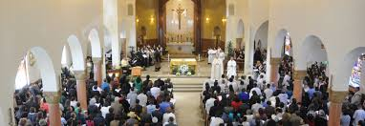
  Culture can be more impactful than programs
  The parish is an adult faith formation program
  The quality of the liturgies
  The extent of shared decision making
  The priorities of the parish budget
  The degree of commitment to social justice
  The quality of the other catechetical programs
Notes:
11:32am The parish is the curriculum
Is our parish community one which “can invite, encourage, and beckon persons into relationship with Jesus Christ? Does your parish have a culture of witness?
The false thinking is that making disciples is about getting people involved. Involvement creates the façade of vibrancy. Look how VIBRANT our parish is! We have something going on every night of the week! Involvement doesn’t lead to discipleship. Interior conversion leads to discipleship. If you have involvement that doesn’t overflow from a relationship with Jesus, your involved people will soon be burned out, scattered, and even bitter.

Slide 18
Adult Faith Formation
“In fact, every aspect and event in parish life can be intentionally fashioned as an occasion for adult faith formation.”
OHWB #112
Think outside of the box!
Notes:
11:33am
Anytime adults are gathered can be an opportunity to intentionally fashion it as an occasion for faith formation. Choir rehearsal, parish picnic planning committees, social justice projects, planning to celebrate the parish feast day…
Focus on parish rather than on program. Every activity that goes on in the parish can be an opportunity for faith formation.
Provide a variety of experiences, programs, activities, resources and social connections that are available anytime and anywhere, in physical spaces and online.
Besides the parish being the curriculum, we need to find ways to plant ourselves in their world. Church life should not be an end to itself. We sponsor and resource faith formation opportunities that happen in the community. Parish leaders must look for ways to connect people to witness their faith to each other in their daily lives.

Slide 19


What about the youth’s and children’s faith?
When it comes to faith, most young people:
Pretty much follow
the faith of their parents.
Notes:
11:49am
The National Study of Youth and Religion is the gold standard of research on youth and faith. Dr. Christian Smith is one of the foremost researchers and analysts of trends in youth and religion.
Parents are the most important factor in the faith equation of their kids.
The best chance we have to ensure that young people have faith is if their parents have faith.
For those of us who lead evangelizing ministries with children, we have an incredible opportunity to reach adults. Our responsibility is always to the whole family and never just the kids.

Slide 20
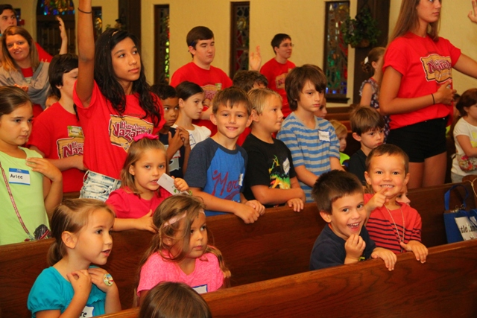
Family Experience
Families have “jobbed out” faith formation to the parish and school
Parish has “jobbed out” faith formation to the catechetical ministry program
Children experience “faith” on foreign territory, the parish plant
Children do not experience faith in the home, or as an integral and integrated part of their everyday lives
Notes:
11:50am
Is this the experience of your families?

Slide 21
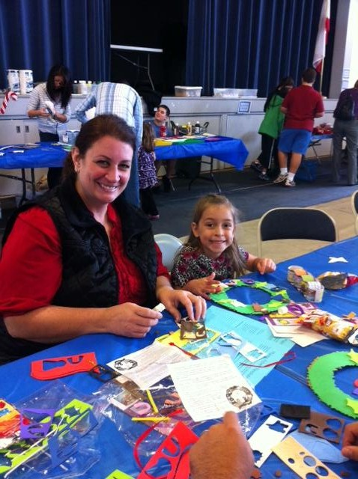
Families and Parents
Design ways to bring families into the evangelization and catechizing process
Design ways for parents to renew their faith and (re)experience conversion
Develop ways to help parents see that the principle onus of evangelization is on THEM
Notes:
11:51am
The church must help families of every sort, and people in every state of life, know that, even in their imperfections, they are loved by God and can help others experience that love. Likewise, pastors must work to make people feel welcome in the church. “Amoris Laetitia” offers the vision of a pastoral and merciful church that encourages people to experience the “joy of love.” The family is an absolutely essential part of the church, because after all, the church is a “family of families” (80). Fr. James Martin, America
The strength of the family “lies in its capacity to love and to teach how to love.”.41
http://w2.vatican.va/content/dam/francesco/pdf/apost_exhortations/documents/papa-francesco_esortazione-ap_20160319_amoris-laetitia_en.pdf

Slide 22
How do we move adult formation to the center?
How do we change a culture?
  Committed leaders are essential
  An unrelenting, uncompromising focus and drive to help people grow into disciples of Christ
  Go with those who want to grow and bless the rest.
  Help people understand the need to change
  Paint a picture of the future
  Identify the benefits to the community and individuals
  Make investments in change; people respond to what they see more than what you say.
Notes:
11:52am “Placing ongoing adult faith formation at the forefront of our catechetical planning and activity will mean real change in emphasis and priorities.” OHWB 14
This is constitutive of your role as a catechetical, young adult, youth leader.
Our marching orders are to become outstanding practitioners of adult faith formation in catechetical ministry through the allocation and application of diocesan and parish organizational assets, resources and services.
We have a model to do adult faith formation, the RCIA
How do we move adult formation to the center? We evoke, envision, equip and evolve. Evoke a sense of urgency among parish and school leadership. Model new partnerships. Form leaders and do immediate and pastoral follow-up on expressed needs.
Expect adults to grow in faith.
Challenge adults to grow in faith.
Encourage adults to let go of their comfortable faith so they can grow.
Support adults in those transitional moments when they seem to be “ losing their faith.
Listen and talk a lot about adult formation and what it looks like to meet the needs of adults.

Slide 23

Notes:
11:59am
It helps to picture the future in order to turn it into a reality.
Every Catholic a disciple
Every Catholic in ongoing formation
Every Catholic experiencing conversion
Every Catholic living faith openly
Every Catholic family forming disciples
Every Catholic involved in sharing faith
Every Catholic an agent of invitation and welcome
Do you embrace this picture?
Then, it’s time for every parish in the Diocese of San Jose to renew their commitment to adult faith formation.
Bishop McGrath relies on our pastoral creativity and dedication to put adults in the center.

Slide 24
Are you ready to walk the path together?
“Being a disciple means being constantly ready to bring the love of Jesus to others, and this can happen unexpectedly and in any place: on the street, in a city square, during work, on a journey”.
(Pope Francis, Evangelii Gaudium#126).
Notes:
12:00pm
After lunch we will look at a Adults at the Center roadmap to reflect on possible strategies to build an adult church, to make disciples of adults. We will share with each other our wisdom, questions, hopes and dreams.

