Slide 1
Universal Synod Listening Session
Your Parish/Community Name

Slide 2
Virtual Listening Shared Norms
We encourage everyone to be on camera to build community
You need to be present and visible. No blank screens or pictures of yourself.
First names only on screen
Once the presentation starts, we recommend using speaker view instead of gallery view.
Chat box should be reserved for asking questions
If you are having any technical issues, private message the volunteer tech coordinator of the session.

Slide 3
Outline of the Listening Session
Gathering Prayer
Short remarks - Bishop video
Explanation of the Purpose, Roles, and Process
Focus the Consultation with Questions
Small Group Table Discussions
Session 1
Break
Session 2
Large Group Feedback
Video & Survey
Sending Forth Prayer

Slide 4
Adsumus Sancte Spiritus
Prayer of invocation to the Holy Spirit
We stand before You, Holy Spirit,
as we gather together in Your name.
With You alone to guide us,
make Yourself at home in our hearts;
Teach us the way we must go
and how we are to pursue it.
We are weak and sinful;
do not let us promote disorder.
Do not let ignorance lead us
down the wrong path
nor partiality influence our actions.
Let us find in You our unity
so that we may journey together
to eternal life
and not stray from the way of truth
and what is right.
All this we ask of You,
who are at work in every place and time,
in the communion
of the Father and the Son,
forever and ever. Amen.

Slide 5
What is the Universal Synod

Slide 6
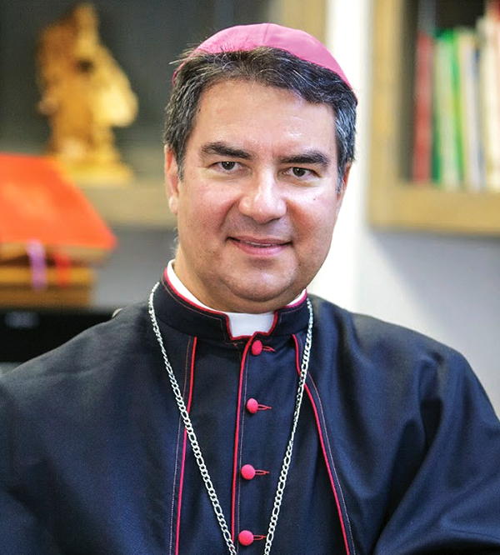
Message from our Bishop…

Slide 7
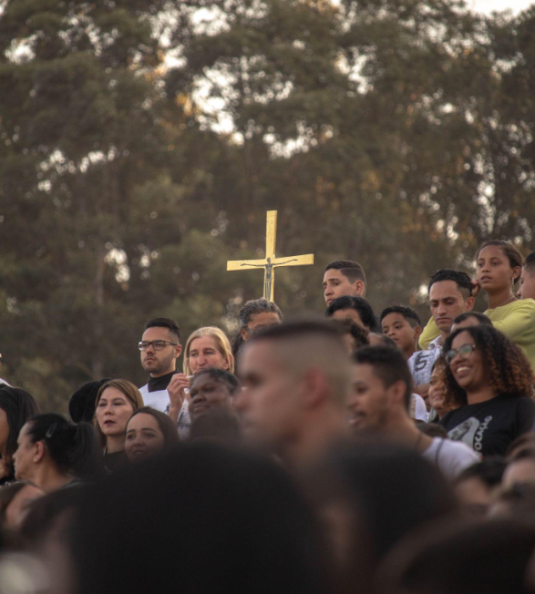
syn = “together” hodos = “road”
synod = “on the road together”
Synodality is a style or mode of being Church, in which we journey together, both clergy and laity, each according to our roles and spiritual gifts
The intention of this process is “to inspire people to dream about the Church we are called to be, to make hopes flourish, to stimulate trust, to bind up wounds, to weave new and deeper relationships, to learn from one another, to build bridges, to enlighten minds, warm hearts and restore strength to our hands for our common mission.”

Slide 9
Listening Session: Participant Ground Rules
Respectful Communication Guidelines - USCCB
R: take RESPONSIBILITY for what you say and feel, and speak with words others can hear
and understand
E: use EMPATHETIC listening, not just words but also feelings being expressed, non-verbal
language including silence
S: be SENSITIVE to differences in communication styles
P: PONDER on what you hear and feel before you speak
E: EXAMINE your own assumptions and perceptions
C: keep CONFIDENTIALITY
T: TRUST the process because we are not here to debate who is right or wrong but to
experience true dialogue.

Slide 10
Questions for the Listening Session
Small Group Session 1:
Where and how do you personally experience Church today? Describe your personal experience
What joys do you experience?
What difficulties and obstacles have you encountered?
What insights do you have?
Small Group Session 2:
What is your dream or vision for our church in the future?
Are there any aspects of the Church's evangelizing mission that you would like to see?
How do you value the Church’s social mission to care for the poor and marginalized, as well as its efforts to address poverty and social change?

Slide 11
Small Group
Session 1

Slide 12
Session 1
Where and how do you personally experience Church today? Describe your personal experience
What joys do you experience?
What difficulties and obstacles have you encountered?
What insights do you have?

Slide 13
Break

Slide 14
Small Group
Session 2

Slide 15
Session 2
What is your dream or vision for our church in the future?
Are there any aspects of the Church's evangelizing mission that you would like to see?
How do you value the Church’s social mission to care for the poor and marginalized, as well as its efforts to address poverty and social change?

Slide 16
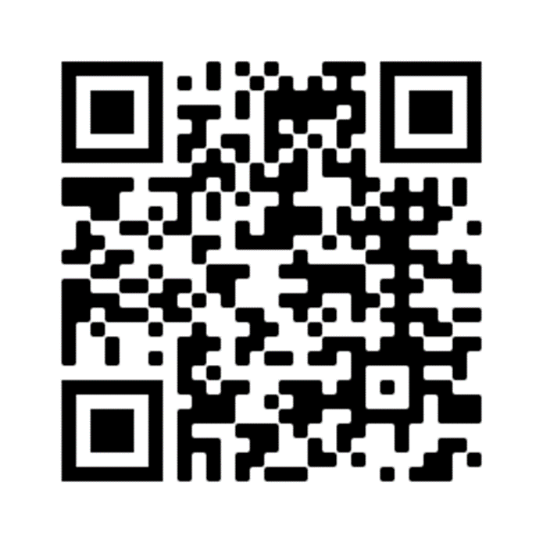
Synod Survey video
https://www.surveymonkey.com/r/6QGC5NV
Notes:
It is estimated that the survey will take most people 12 minutes.

Slide 17
Large Group

Slide 18
Prayer of Pope Francis
Prayer of invocation to the Holy Spirit
Come, Holy Spirit!
You inspire new tongues and place words
of life on our lips:
keep us from becoming a museum Church,
beautiful but mute,
with much past and little future.
Come among us,
so that in this synodal experience
we will not lose our enthusiasm,
dilute the power of prophecy,
or descend into useless
and unproductive discussions.
Come, Spirit of love!
Open our hearts to hear your voice.
Come, Holy Spirit of holiness!
Renew the holy and faithful People of God.
Come, Creator Spirit!
Renew the face of the earth!
Amen.
Notes:
Prayer of Pope Francis at the opening of the Synod on Synodality

Slide 19
Thank You!

